Slide 1

Digitization
Mikołaj Leszczuk, Jakub Nawała
MIPaC
Notes:
In the context of multimedia - in particular, images.
Why MIPaC? - it is the english name of the course (in your syllabus: Przetwarzanie i przesyłanie informacji multimedialnych).

Slide 2
Why Digital Systems?
To process real-world (i.e., analogue) data using computers.
Digital signals are easier to interleave.
Switching analogue signals is expensive.
Switching digital signals is cheap.
Filtering of digital signals performs better than its analogue counterpart.
Notes:
Computers are digital by their nature. There is some interface needed to feed them with real-world data.
Digital signals are easier to interleave - many separate signals can be sent through the same channel (cable).
Switching analogue signals is expensive. It is usually done through mechanical switches.
Switching digital signals is cheap. You just have to change a state of a transistor (or many transistors). No direct human involvement is required.
Filtering of digital signals performs better (...). If one wants to design a well performing analogue filter, it takes many elements and a lot of knowledge.

Slide 3
Digitization in Image Processing
Digital images are a special type of signals
they measure a parameter over space (and not time).
Their quality is highly subjective.
They contain a lot of information.
Frames per second
1920 x 1080 x 24 x 25 ≅ 1.24 Gb→ 155.52 MB
Resolution
(in pixels)
Number of
bits per pixel
Size of 1 s long video
Notes:
We focus on images since this is the main topic of this subject.
--
Their quality is highly subjective. There is no objective method to judge image quality. Someone can prefer images to be more blurry than others. Content has a huge influence.
They contain a lot of information. 10 MB are required to store 1 s of a video. This is approximately 1000x more than for a similarly long voice signal (true as of 1997). Of course, this ratio depends on resolution, FPS and a number of bits per pixel. + See the equation.

Slide 4
What Must Be Done?
We must have proper sensors to store digital data.
We must have proper interfaces to transmit digital data.
We must send only the most important information.
Notes:
--
--
We must send only the most important information. Ideally, we want to store only the data that is perceptually important.

Slide 5
What Is Actually Done?
We use proper sensors.
We compress multimedia signals to make their storage and transmission easier.
Notes:
See the next slide,
--

Slide 6
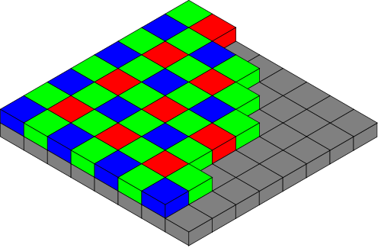
Image Sensor
Semiconductors based.
Consists of pixels.
One photodetector for each pixel (true for Active Pixel Sensor, APS - also called CMOS Sensor).
Bayer filter to distinguish between colours.
Image taken from Wikimedia Commons. For an author and licensing for the upper image see here.
Notes:
This performs ADC functionality.

Slide 7
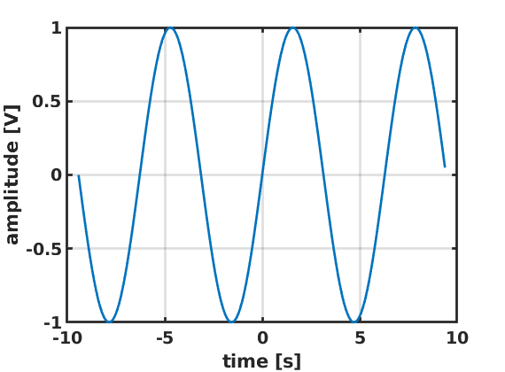
Signal Digitization
Low Frequency Sinusoidal Component
Notes:
Just a plain simple sinusoid.

Slide 8
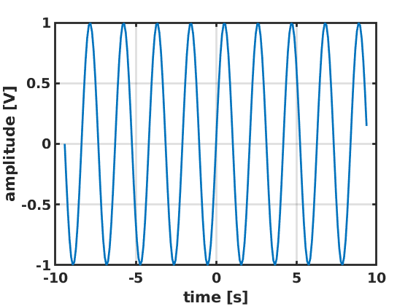
Signal Digitization
High Frequency Sinusoidal Component
Notes:
Another sinusoid, this time of higher frequency.

Slide 9
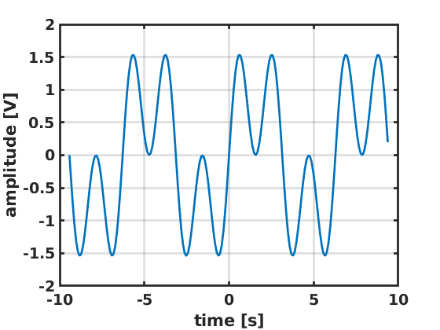
Signal Digitization
Time-Varying Analogue Signal
Notes:
This signal is a result of adding two previous signals.
Now is the question: what this analogue adjective stands for?

Slide 10
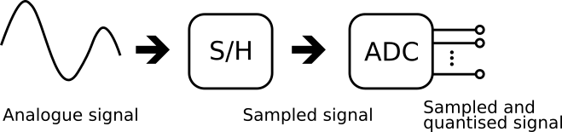
Analogue-to-Digital
Conversion
continuous in time
continuous in value
discrete in time
continuous in value
discrete in time
discrete in value

Slide 11
Analogue Signals
This example: signal components between lowest and highest frequency
Spectrum analysis (aka Fourier analysis)
Time-varying analogue signal = possibly infinite number of single-frequency sinusoids
Range of frequencies of sinusoids = signal bandwidth

Slide 12
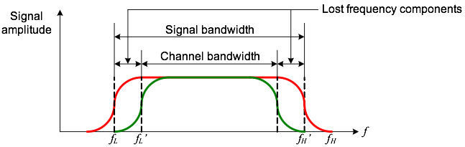
Effect of Limited Bandwidth Transmission Channel
Analogue signals transmitted through networks
Ideally, if range of channel frequencies ≥ bandwidth of signal
If channel bandwidth < some frequency components lost → band-limiting channel

Slide 13
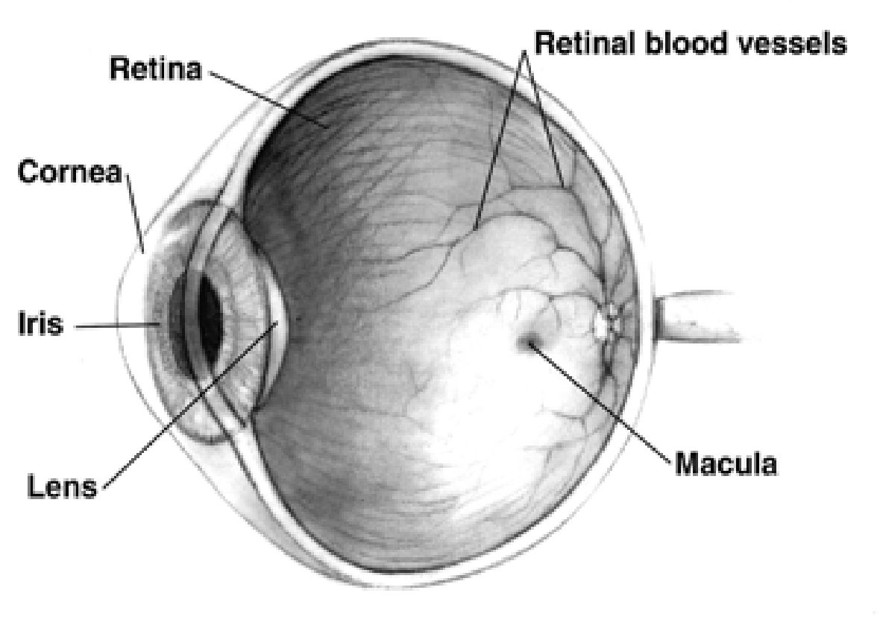
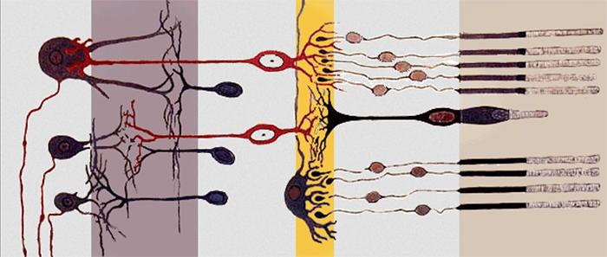
Human Vision Sensors
Rods – luminance (light level); ~ 90 mln.
Cones – chrominance (3 types, each sensitive to a different colour): Red, Green, Blue; 4.5 mln.
Notes:
I talk about this to introduce a topic of perceptually-focused compression.
Rods - pol. pręciki; can sense a single photon; we have approx. 90 million of them.
Cones - pol. czopki; concentrated near the fovea centralis (małe zagłębienie w centrum plamki żółtej siatkówki); less sensitive than rods; we have approx. 4.5 million of them.

Slide 14
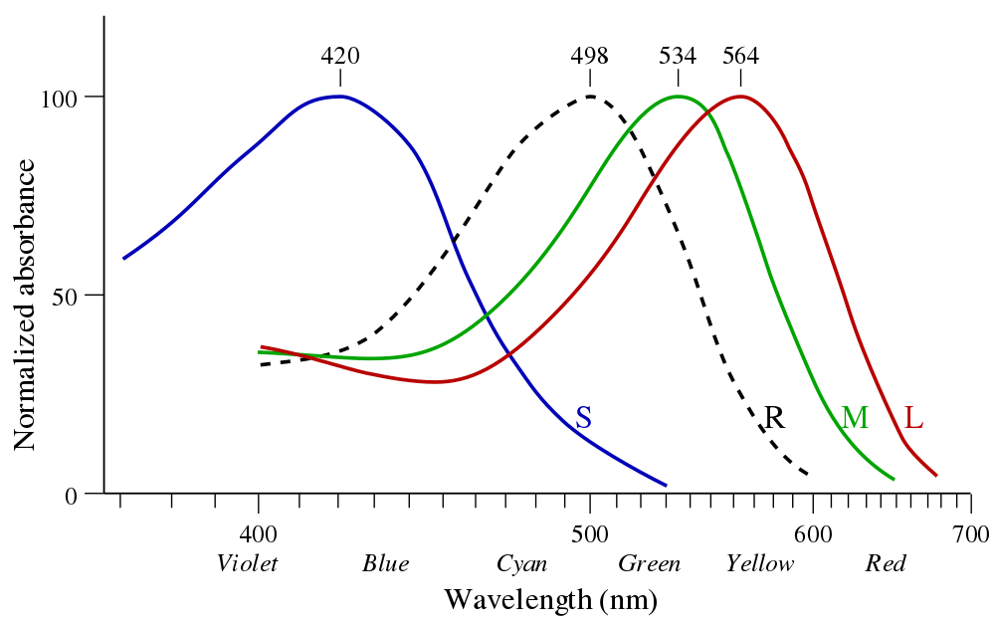
Human Vision Sensors
Image taken from Wikimedia Commons. For an author and licensing for the upper image see here.
Notes:
S - small wavelength, M - medium wavelength, L - long wavelength
R - rods (pol. pręciki)

Slide 15
Human Visual System (HVS) Model
Models biological and psychological processes in human body related with visual stimuli perception.
The most important observations:
Lows-pass filter (due to a limited number of rods),
Low color resolution (fewer cones than rods),
Motion sensitivity (stronger than texture sensitivity),
Texture stronger than disparity.
Notes:
Stimuli = pod. bodźce

Slide 16
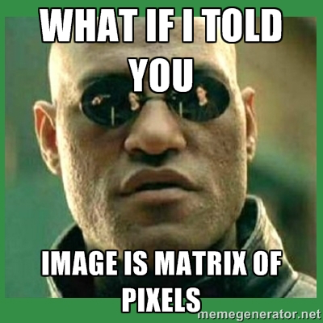

Slide 17

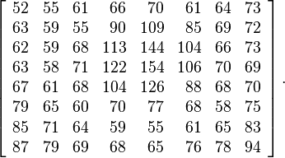
How Matrix Represents Pixel Colours
„JPEG example subimage” by en:User:Cburnett – Own work in Inkscape based on the following data:. Licensed under CC BY-SA 3.0 via Commons – https://commons.wikimedia.org/wiki/File:JPEG_example_subimage.svg#/media/File:JPEG_example_subimage.svg

Slide 18
Image Types
True-colour (RGB) – generated by digital camera & widely used in computer graphics
(Scale) indexed – often used to display scientific/engineering data with colour scale
Grayscale – often used in image processing/analysis algorithms
Binary – often used as mask to indicate segmentation results/region of interest

Slide 19
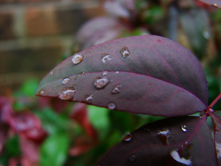
True-Colour (RGB) Images
Each image pixel has 3 components
Values associated with it:
Red
Green
Blue
Matrix representation: 3D array of M⨉N⨉3
“True-colour” by Thegreenj – Own work. Licensed under CC BY-SA 3.0 via Commons – https://commons.wikimedia.org/wiki/File:Truecolor.png#/media/File:Truecolor.png

Slide 20

(Scale) Indexed Images
Not determining pixel colours
Using matrix values as indices
Looking up colours in colour-map
“8 bit” by Thegreenj – Own work. Licensed under CC BY-SA 3.0 via Commons – https://commons.wikimedia.org/wiki/File:8_bit.png#/media/File:8_bit.png

Slide 21
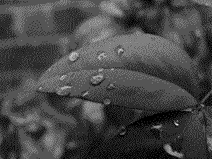
Grayscale Images
Only brightness information
Using grayscale colour-map
“2 bit” by 8_bit.png: JorgePeixotoderivative work: User:JeffyP - 8_bit.png. Licensed under CC BY-SA 3.0 via Commons – https://commons.wikimedia.org/wiki/File:2_bit.PNG#/media/File:2_bit.PNG

Slide 22
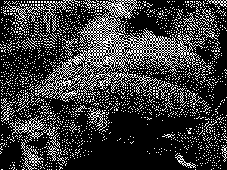
Binary Images
Containing only black/white pixels
Often output of image segmentation
Binary image, where:
White pixels: object of interest
Black pixels: background
“1 bit” by Thegreenj – Own work. Licensed under CC BY-SA 3.0 via Commons – https://commons.wikimedia.org/wiki/File:1_bit.png#/media/File:1_bit.png

Slide 23
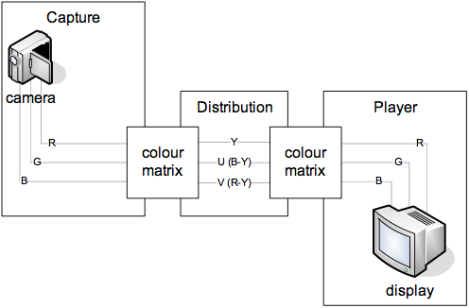
Colour Space Conversion – RGB and YUV
Y – Luminance
C – Chrominance:
U (B-Y)
V (R-Y)
Related to pixel formats and FourCC codes.
Notes:
YUV used for historical reasons (colour TV existing alongside B&W TV).
Nevertheless, the usage of such a system nicely fits HVS. We can reduce colour channels bandwidth without losing the perceptual quality.
FourCC—’A FourCC is a sequence of four bytes used to uniquely identify data formats. It originated from the OSType or ResType metadata system used in classic Mac OS and was adopted for the Amiga/Electronic Arts Interchange File Format and derivatives. The idea was later reused to identify compressed data types in QuickTime and DirectShow.’ (from Wikipedia) Examples: YV12 (=YUV420p)
Mention that Y’ means luma (i.e., perceptually uniform brightness).

Slide 24
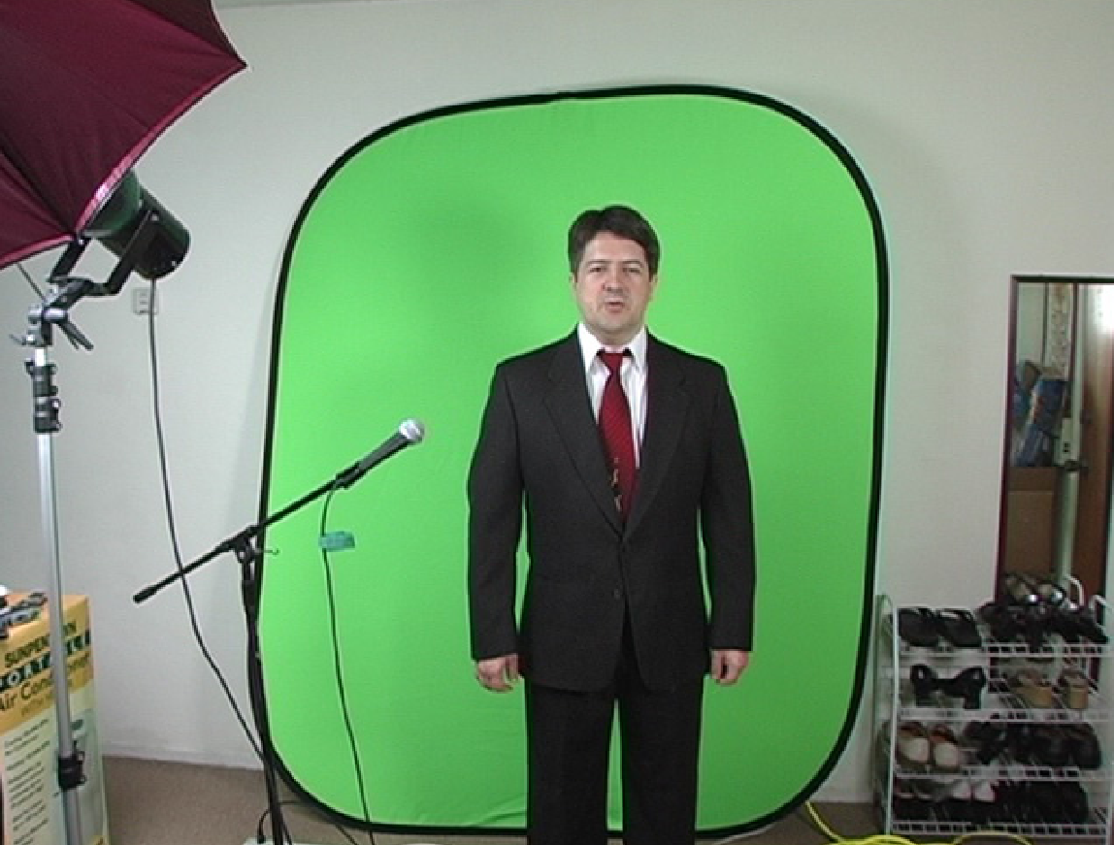
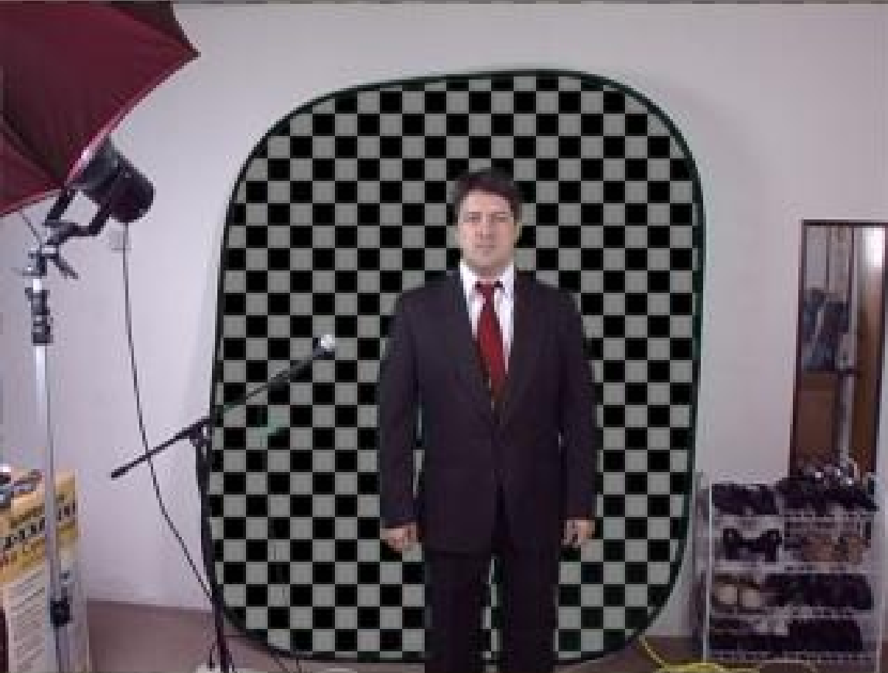
Chroma Keying Special Effects

Slide 25
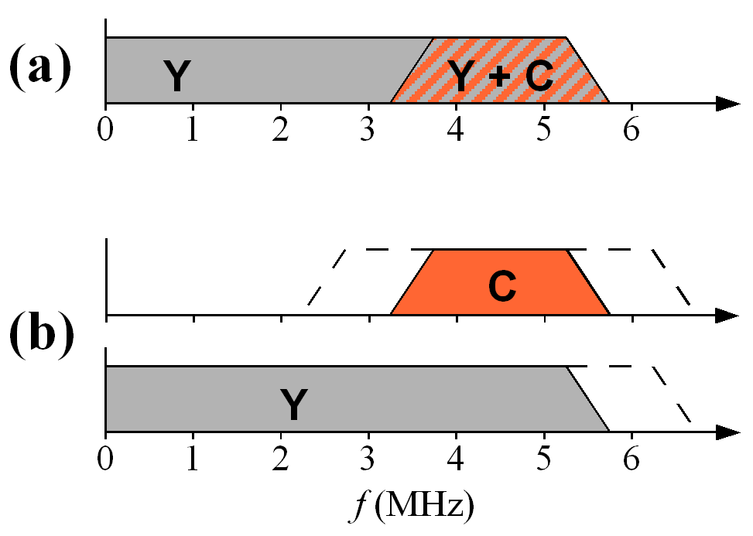
Chrominance Band Limiting
Human eye perception:
Lower C detail – lower resolution
Higher Y detail – higher resolution
More bandwidth for Y than for C
In analogue system transmitted:
Composed together
Separated
By Michael Schmid – Drawing created myself, CC BY 2.5, https://commons.wikimedia.org/w/index.php?curid=446797

Slide 26
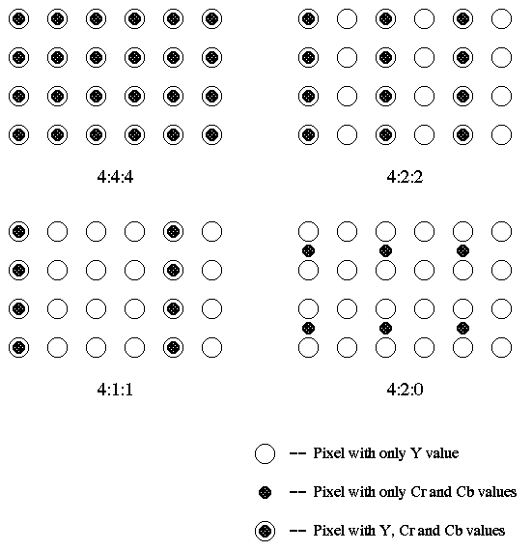
Sampling Structures
Source:
„Basics of Video”
http://lea.hamradio.si/~s51kq/V-BAS.HTM

Slide 27
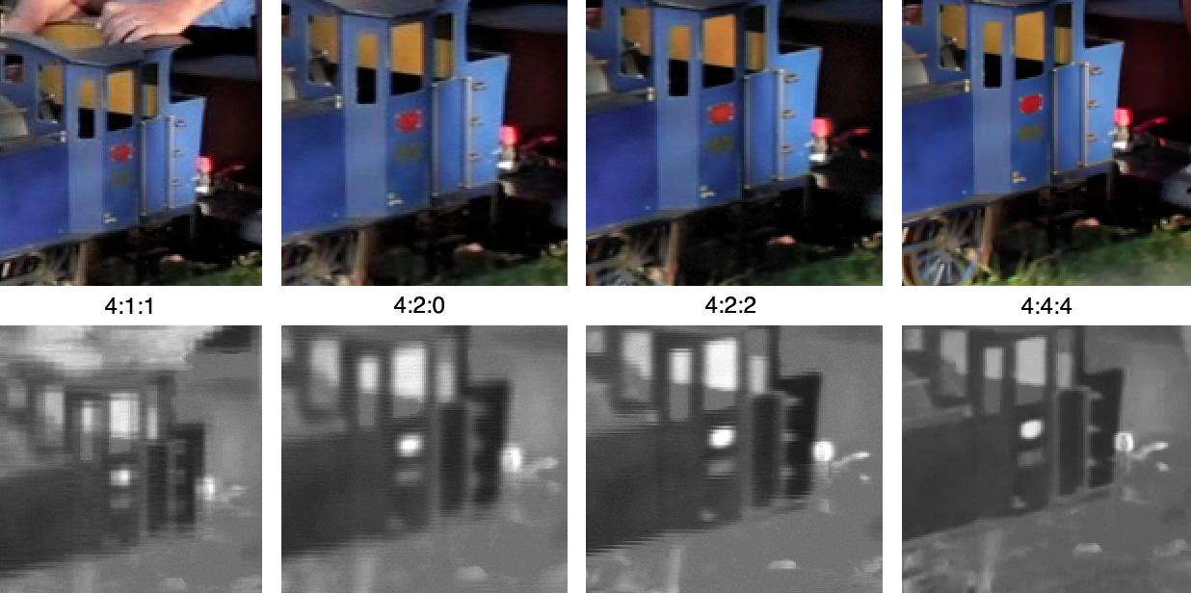
“Colorcomp” by Janke – I (Janke). Licensed under CC BY-SA 3.0 via Wikipedia – https://en.wikipedia.org/wiki/File:Colorcomp.jpg#/media/File:Colorcomp.jpg
Notes:
Bottom row represents the R channel from the original frame.

Slide 28
Ground Rules of Video Digitization
3 colour channels
525-4320 television lines
8-12 bits per channel

Slide 29
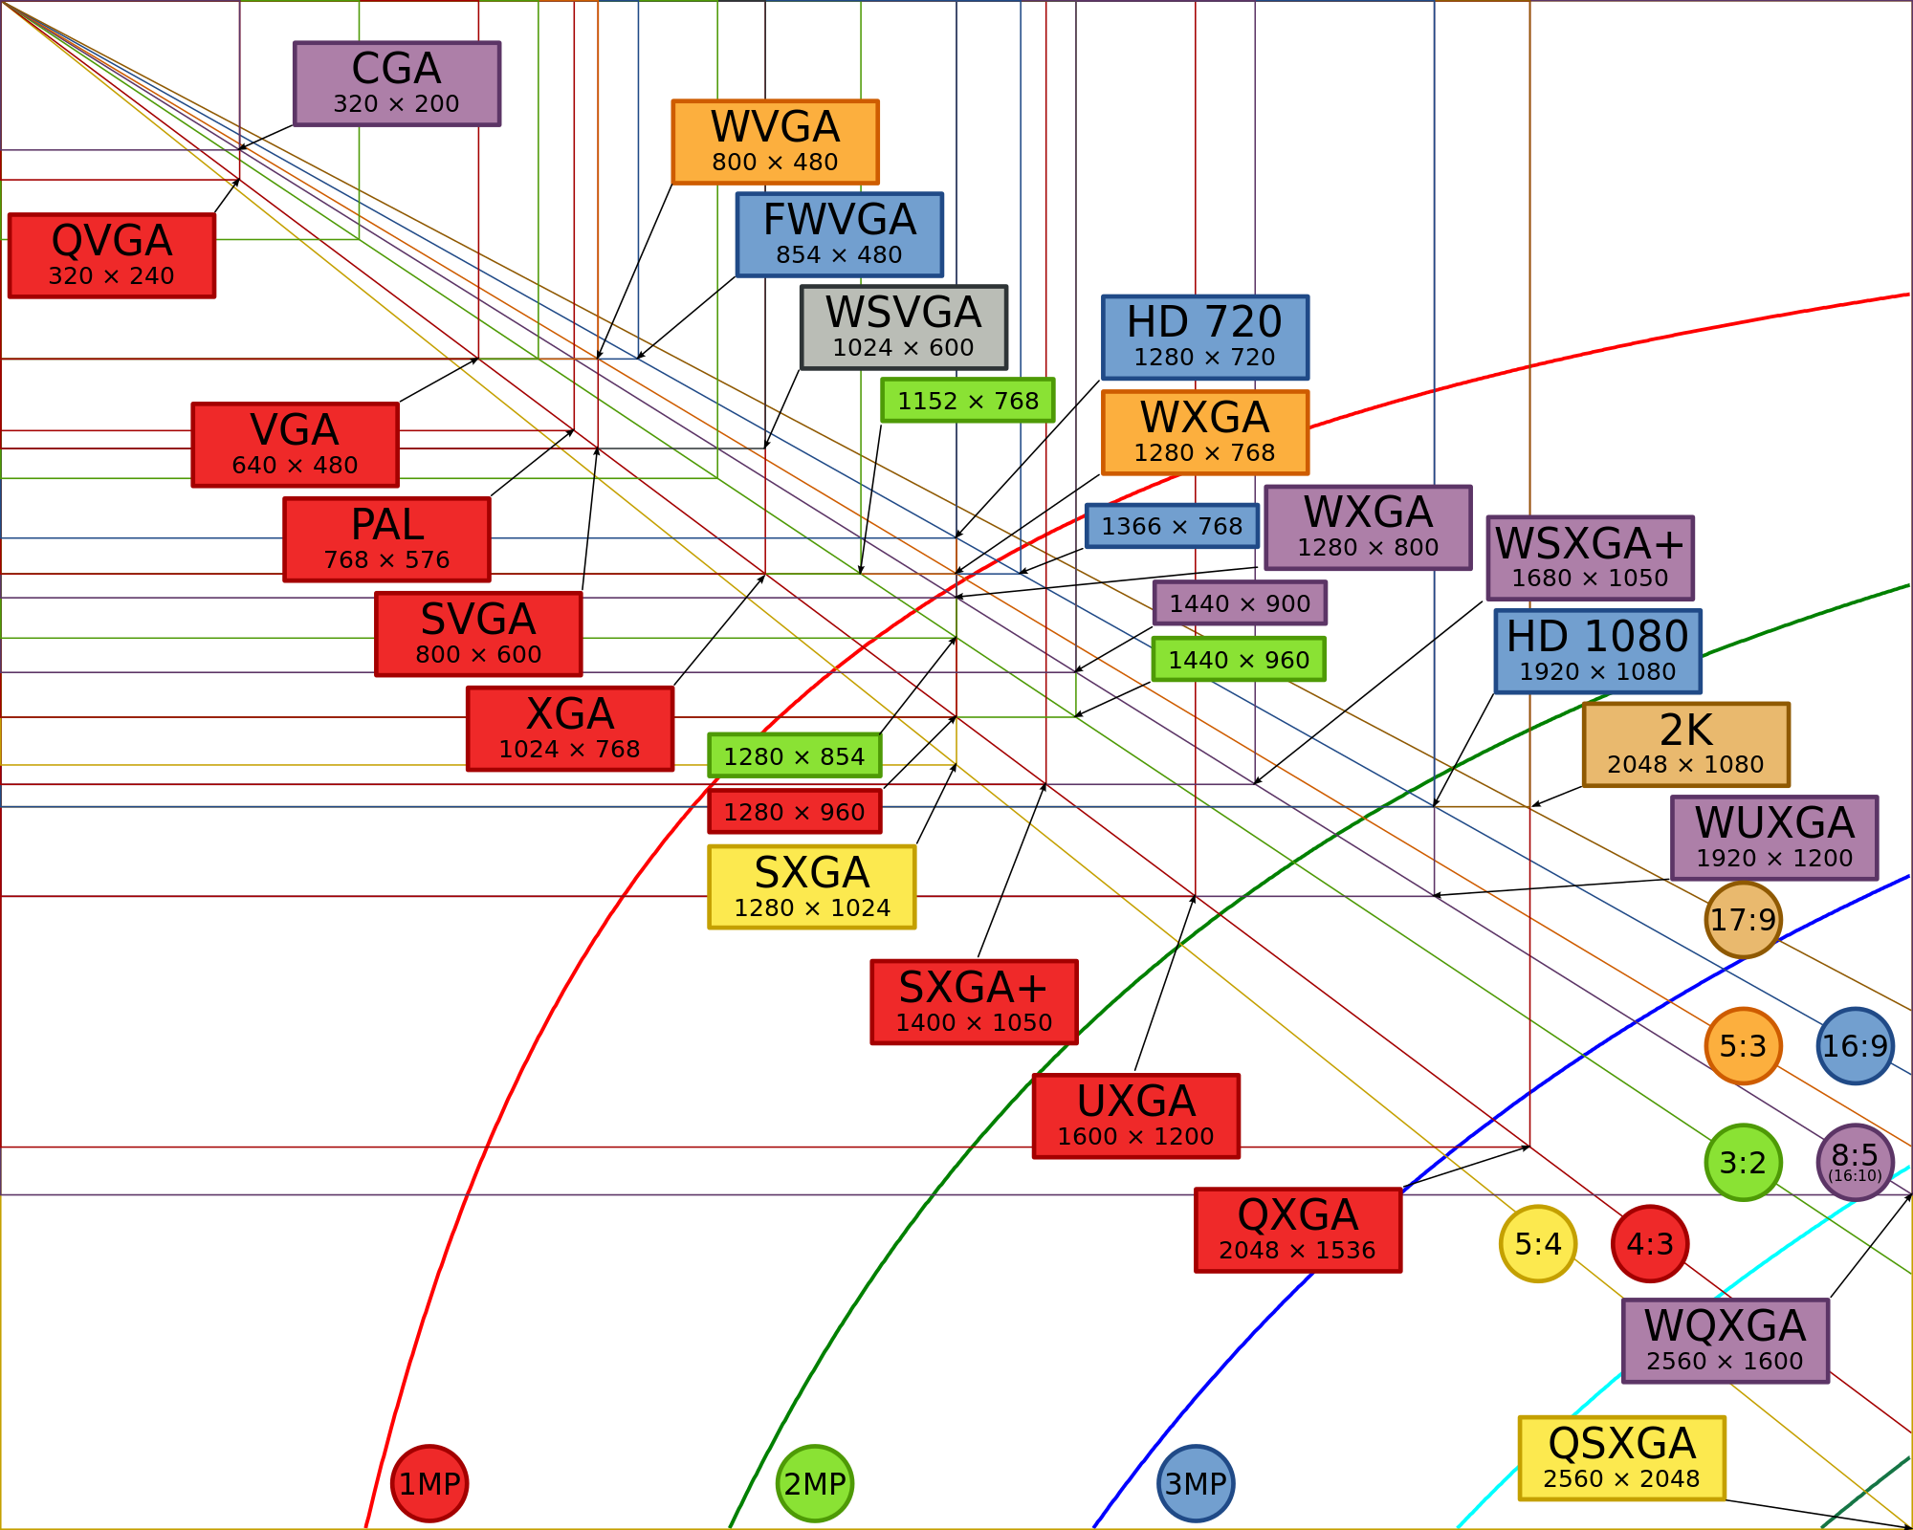
Common Display Resolutions
"Vector Video Standards2" by Original uploader was XXV at en.wikipedia. Later version(s) were uploaded by Jjalocha, Aihtdikh at en.wikipedia. – sTransferred from en.wikipedia. Licensed under CC BY-SA 3.0 via Wikimedia Commons – https://commons.wikimedia.org/wiki/File:Vector_Video_Standards2.svg#/media/File:Vector_Video_Standards2.svg

Slide 30
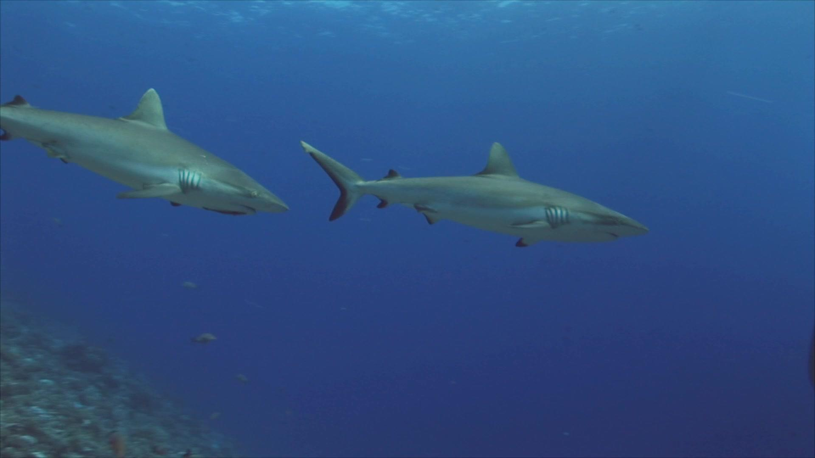

Video Compression
Sneak Peak
Upper from raw video stream,
Lower compressed,
Raw video stream size: ~389 MB,
Compressed size: ~300 KB,
Smaller more than 1300 times!
Video frames extracted from footage taken from videvo.net. For an author and licensing of the full footage see here.
Notes:
More details to follow on classes devoted to video compression.

